Slide 1
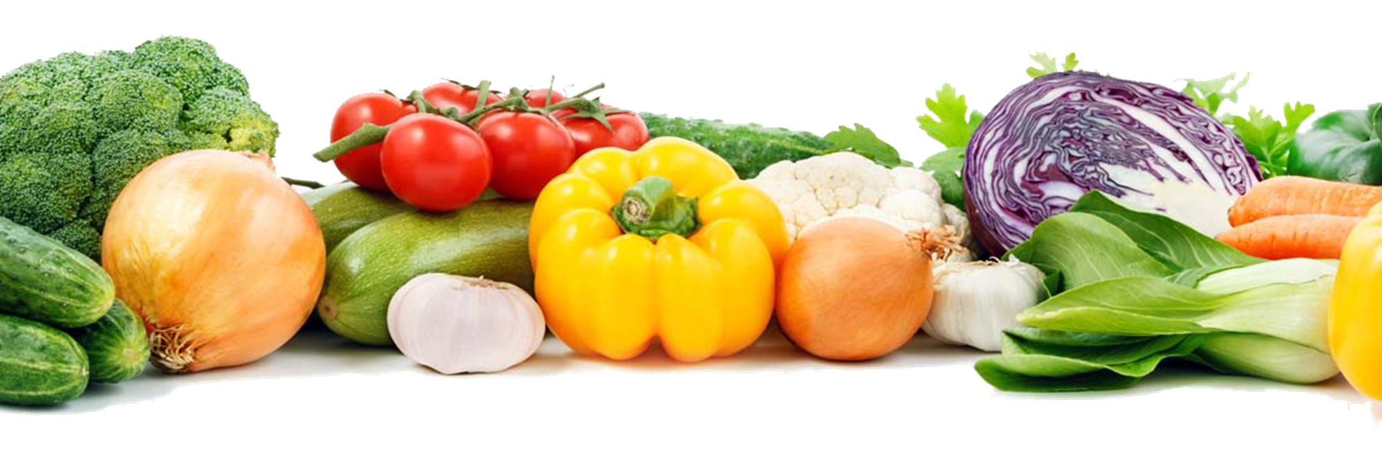
Organic Vegetable Ontology
Advance web development
Sir Saad
By: Amna Safder
msit71f22s003

Slide 2
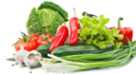
General Purpose:
Organic growing and vegetable information system
This ontology will supports agriculture students and humans or persons to finds answers related to vegetables; to find how to sow, grow, care and use, eat, store vegetables either at home yard or at farm. The ontology purpose also includes to classify vegetables on basis of underground and above ground vegetables along with their growing and care instructions, common and scientific names, mineral and vitamins and also storing vegetables for future uses.

Slide 3
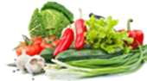
Scope
Vegetables classified on basis of vegetable being above ground or underground along their common names known in Pakistan, English names beside with scientific names. So it can facilitate common person who have no knowledge of scientific names and also help students to learn scientific names.
Sowing domain includes on-farm or house yard level production, amount of water, temperature needs, organic fertilizers, seasons along months for sowing, common human diseases that each vegetable can cure along their vitamins and minerals existence.
Harvesting domain includes best time to harvest and methods, and store involves techniques to store in raw form without chemicals (so that purpose of organic vegetables can be achieved) plus in cooked form storing instructions.

Slide 4
End Users
User 1: Agriculture students
User 2: Farmers
User 3: House wives
User 4: Ontology repository

Slide 5
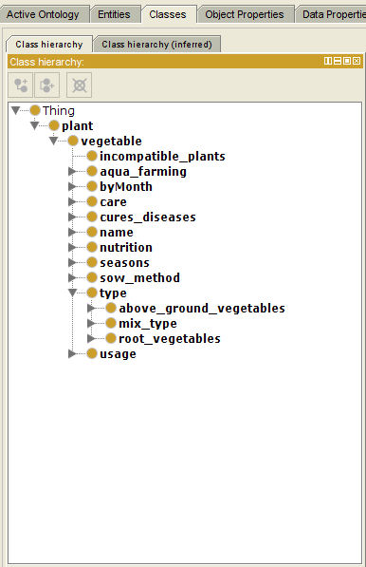
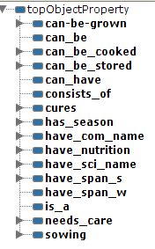
Ontology figures

Slide 6

Thank you

